Slide 1
SE 2228 – C++
Lab Session 1

Slide 2
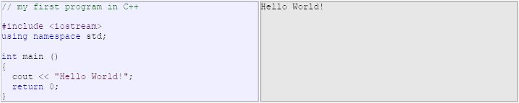
Structures of a Program

Slide 3
Structures of a Program
// my first program in C++
- The lines that begin with // are comment lines which do not have any effect on the code. You can also put comments by using blocks (/*.....*/)
# include <iostream>
- The lines that begin with # are directives for the processor. They indicate the compiler’s preprocessor. The example iostream is the standart input output library which provide input and output for the program.
using namespace std;
- All the elements of standard C++ library are declared in std namespace, which must be used in order to provide their functionalities in our code.
int main ()
- Main function is the part that C++ programs start their execution independently of their location in the source code. The instructions in the main function are the first ones that execute. All C++ programs should have a main function.

Slide 4
Structures of a Program
int main ()
- The parantheses are used since main is a function and the functions in C++ are declared with parantheses. With respect to the code, these parantheses can include parameters which define the input of the function. {} part are the body part of a function which shows the steps that will be done in the execution.
cout<<“Hello world!”;
- cout is a C++ statement. The statements are expressions that have some effects on the code. Cout, is an expression that produces output for the program. The output will be the hello world as defined here, however, the output can be modified by using different variable types.
return 0;
- return statement finishes the main function. It can be followed by a return code (here with 0). Return 0 is interpreted as the program executed as expected and no errors occured.

Slide 5

Variables
Variables are special data types that are used to store the values in order to be used in the following parts of the program. As an example, we can give the sum operation which we have to store 2 values to be used in sum operation and then store the result in another variable in order to use it as the output of the program. It can be done with the following code:
Each variable needs an identifier that defines its type. In c++ we have lots different identifiers, in the example that is shown the variables are integer data types which represent mathematical integers.
Their declaration is done by (for the given example);
For other types we use their notations (for characters char, booleans bool, numbers with fractional parts float , etc.)

Slide 6
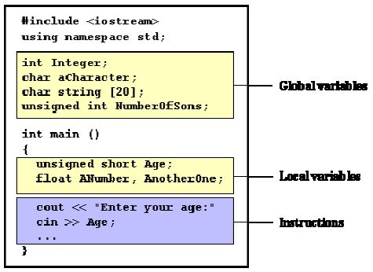
Scope of Variables
A variable can be global or local scope. This information is related with the location of declaration of the variable. Global variables are declared outside of all functions and they are effective everywhere in the source code where local variables are declared in functions or blocks and can not effect outside of their declaration locations.

Slide 7
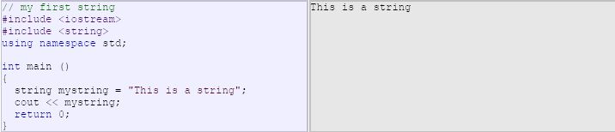
Initializing Variables
Two ways of initializing:
1: int a = 0;
2: int a(0);
Both ways do the same operation, which is setting a’s initial value as 0.
There are also another variable type which stores non-numerical values. They are called strings. In order to enable their functionality, string header file must be included in the code (# include <string>).

Slide 8
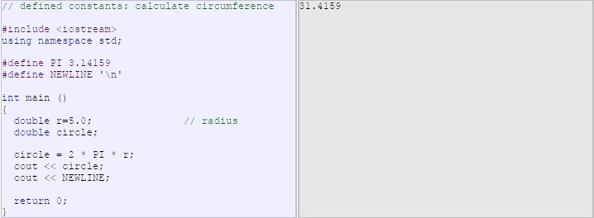

Constants
Defined Constants:
Declared Constants:

Slide 9
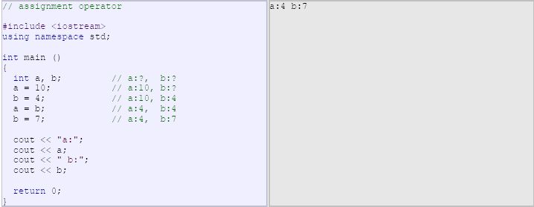
Operators
Assignment (=)
- Assigns a value to a variable. The assignment operation always takes place from right to left, never the ther way (right-to-left rule).

Slide 10
Operators
Assignment (=)
- a = 5;
Arithmetic Operators:
+ addition
- subtraction
* multiplication
/ division
% modulo
Compound assignment (+=, -=, *=, /=, %=, >>=, <<=, &=, ^=, |=)
expression is equivalent to
value += increase; value = value + increase;
a -= 5; a = a - 5;
a /= b; a = a / b;
price *= units + 1; price = price * (units + 1);

Slide 11
Operators
Increase and Decrease (++ , --)
- a++ <=> a = a + 1;
- However, the operators can be used as prefix (++a) or suffix (a++). If prefix notation is used, it means the value is increased before the result of the expression is evaluated and the increased value is considered in the outer expression. If suffix notation is used, then the value is increased after the evaluation and the value before increase operation is evaluted.
Ex: B=3; B=3;
A=++B; A=B++;
// A contains 4, B contains 4 // A contains 3, B contains 4
Relational and Equality Operators ( ==, !=, >, <, >=, <= )
== Equal to != Not equal to > Greater than < Less than
>= Greater than or equal to <= Less than or equal to

Slide 12
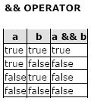
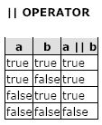
Operators
Logical operators ( !, &&, || )
!(5 == 5) // evaluates to false because the expression at its right (5 == 5) is true.
Conditional Operator (?)
7==5 ? 4 : 3 // returns 3, since 7 is not equal to 5.
7==5+2 ? 4 : 3 // returns 4, since 7 is equal to 5+2.
Sizeof ()
a = sizeof (char); //this will assign value 1 to a since char is a one-byte long type.

Slide 13



Basic Input/Output
Standard Output (cout)
Standard Input (cin)
Stringstream
- The standard header file <sstream> defines a class called stringstream that allows a string-based object to be treated as a stream. This way we can perform extraction or insertion operations from/to strings, which is especially useful to convert strings to numerical values and vice versa. For example, if we want to extract an integer from a string we can write:

Slide 14


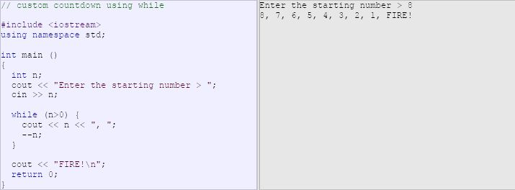
Control Structures
Conditional Structure : if and else
Iteration Structures (loops)
The while loop:

Slide 15
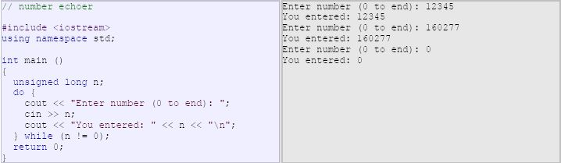
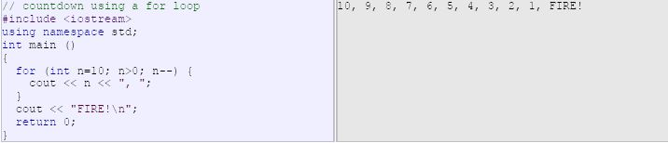
Control Structures
The do-while loop
The for loop

